Slide 1
Digital Portfolio
STUDENT NAME : R. Kanimozhi
REGISTER NO AND NMID : 2422j0206 and asbrubd2422j0206
DEPARTMENT : Computer Applications
COLLEGE: COLLEGE/ UNIVERSITY : Shree Venkateshwara Arts and Science College by Bharathiar University

Slide 2
PROJECT TITLE
STUDENT
DIGITAL
PORTFOLIO

Slide 3


AGENDA
Problem Statement
Project Overview
End Users
Tools and Technologies
Portfolio design and Layout
Features and Functionality
Results and Screenshots
GitHub Link
Conclusion
3/21/2024 Annual Review

Slide 4

PROBLEM STATEMENT
There is a growing need for a dynamic, interactive, and visually appealing platform that allows individuals—especially students and professionals—to effectively showcase their personal brand, technical expertise, and accomplishments.

Slide 5

PROJECT OVERVIEW
A digital portfolio is a curated collection of work that showcases your skills, experience, and achievements in a specific field or industry. The purpose of this project is to create a visually appealing and interactive digital portfolio that effectively communicates your professional brand and story.

Slide 6

WHO ARE THE END USERS?
Designed for students to growth, educator to track, progress and parents to witness achievements - all in one seamless platform.

Slide 7

TOOLS AND TECHNIQUES
Tools
Design Tools - Figma / Adobe XD – For wireframing and UI design - Canva – For creating graphics and personal branding - Adobe Photoshop / Illustrator – For image editing
Development Tools - VS Code – Code editor for writing HTML, CSS, and JavaScript - Git & GitHub – Version control and code hosting
Testing Tools - Browser Developer Tools – For real-time testing and debugging - Responsive Design Checker – To test on various screen sizes
Deployment Tools - GitHub Pages – For free static hosting - Netlify / Vercel – Easy deployment with continuous integration - Firebase – For hosting and backend (if needed)
Productivity Tools - Trello / Notion – Project planning and task management - Google Docs / Slides – Documentation and presentation
Techniques
Front-End Technologies - HTML5 – Structure and content of the portfolio - CSS3 – Styling, layout, and responsiveness - JavaScript – Interactive features and client-side logic
Front-End Frameworks (optional) - Bootstrap / Tailwind CSS – For responsive and faster UI design - React.js – For dynamic component-based user interfaces
Version Control - Git – For tracking code changes - GitHub – For hosting and collaborating on code
Hosting & Deployment - GitHub Pages – Free static website hosting - Netlify / Vercel – Continuous deployment and hosting - Firebase – Hosting + backend services if required
Optional Enhancements - Animations with CSS or GSAP - Form handling with JavaScript or backend integration

Slide 8
POTFOLIO DESIGN AND LAYOUT
Homepage (Landing Page) - Clean and minimal design - Welcoming message or tagline - Personal photo or logo - Navigation bar with smooth scrolling
About Me Section - Brief introduction - Educational background - Skills summary - Professional goals
Projects Section - Grid or card-based layout - Each project includes: - Title, description - Technologies used - Links to live demo or GitHub
Skills Section - Visual representation (bars, icons, or charts) - Categorized: Front-end, Back-end, Tools
Resume Section - Downloadable PDF option - Summary view on the page
Contact Section - Simple contact form - Email & social media links - Location (optional)
Footer - Copyright info - Quick links - “Back to top” button
8

Slide 9
FEATURES AND FUNCTIONALITY
Project Showcase - Ability to display projects with descriptions, images, live demos, and links to source code.
Interactive & Accessible - Responsive design, easy navigation, and multimedia support (videos, embeds, documents).
Professional Connectivity - Integrated contact section with links to email, LinkedIn, GitHub, or resume.
9

Slide 10
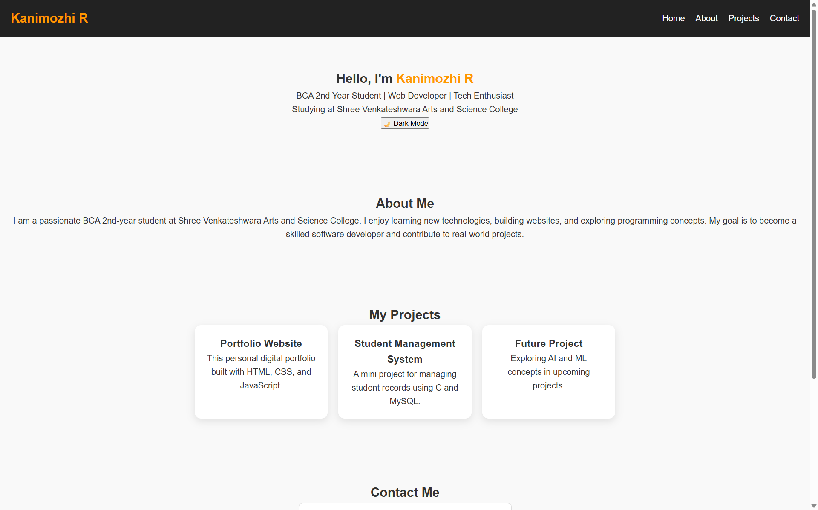
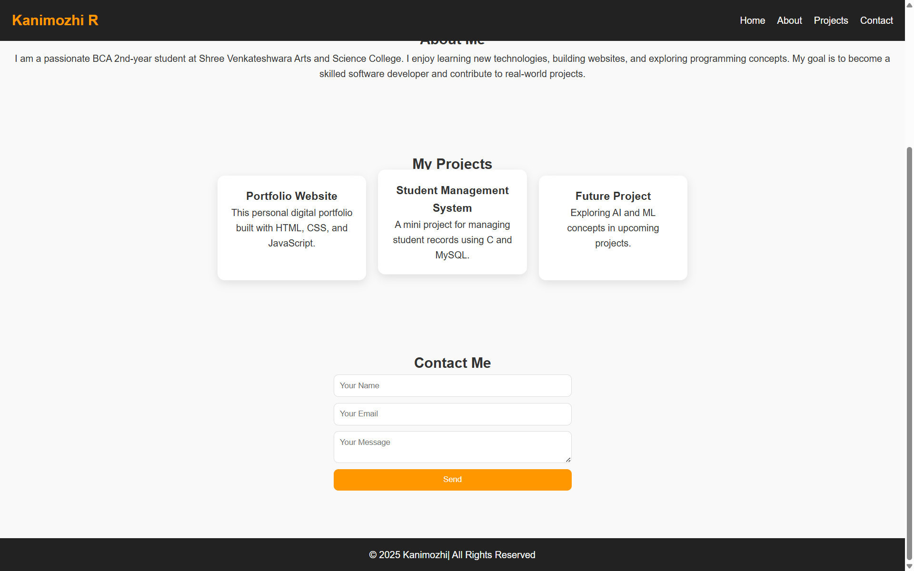

RESULTS AND SCREENSHOTS
10

Slide 11
GitHub Link
https://github.com/kanimozhisvasc-coder/Kani-2006.git
11

Slide 12
CONCLUSION
This portfolio highlights my growth, skills, and creativity as a learner. It reflects my progress so far and my commitment to keep learning, improving, and taking on new challenges in the future.
12

